Slide 1
Bluetooth Doorknob
By: #include <name.h> (Muhsin, Faayez, Faraaz, Chanakya)
MYP4

Slide 2
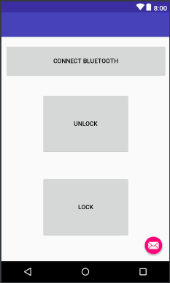
Bluetooth doorknob
The Bluetooth doorknob is a machine that allows a person with the specific app to unlock the door with the press of a button.

Slide 3
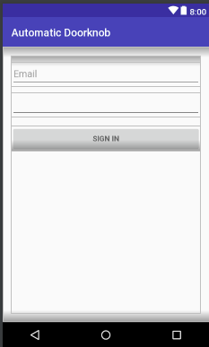
Security
The app that’s connected to the doorknob starts off with a login screen
Increases security as connectivity with just Bluetooth could easily be hacked into, compromising the security of the house

Slide 4
Hardware/software used
Arduino Uno
HC-06 Bluetooth module
Arduino IDE
Android Studio

Slide 5
Possible improvements
More security – such as a firewall, a camera to monitor who enters the house, etc.
Spreading the concept throughout the whole house – such as for windows, child management etc.

